Slide 1


1

Slide 2

Lecture Objectives
Characteristics of the Database Approach
Personnel involved in the DBMS environment.

Slide 3
Characteristics of the Database Approach
Self-describing nature of a database system
Insulation between programs and data Abstraction
Support of multiple views of the data
Sharing of data and multi-user transaction processing

Slide 4
1. Self-describing nature of a database system
Database system
Database
DBMS Catalog
complete definition or description of the database structure and constraints.
DBMS software - general-purpose - not written for a specific database application
Refer to the catalog
To know the structure of the files in a specific database,
such as the type and format of data it will access.

Slide 5
1. Self-describing nature of a database system
DBMS software work with any number of database applications
University database
Banking database
Company database
File processing, data definition is typically part of the application programs
Programs are constrained to work with
only one specific database,
whose structure is declared in the application programs

Slide 6
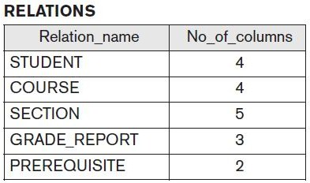
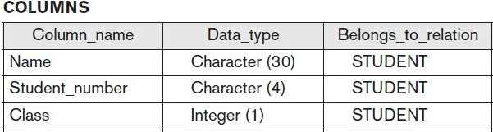
1. Sample DBMS Catalog

Slide 7
2. Insulation between programs and data
Traditional file processing
the structure of data files is embedded in the application programs,
so any changes to the structure of a file may require changing all programs that access that file.
Program-data independence.
DBMS programs do not require such changes .
The structure of data files is stored in the DBMS catalog

Slide 8
2. Insulation between programs and data
object-oriented and object-relational systems
users can define operations on data as part of the database definitions.
An operation (also called a function or method) is specified in two parts.
The interface (or signature)
implementation (or method)
User application programs can operate on the data by invoking these operations
regardless of how the operations are implemented.
Program-operation independence.

Slide 9
2. Insulation between programs and data
The characteristic that allows program-data independence and program-operation independence is called data abstraction.
DBMS provides users with a
conceptual representation of data that does not include many of the details of
how the data is stored or
how the operations are implemented

Slide 10
3. Support of multiple views of the data
A database typically has many types of users, each of whom may require a different perspective or view of the database.
A view may be a subset of the database or it may contain virtual data that is derived from the database files but is not explicitly stored.
Users - whether the data they refer to is stored or derived.

Slide 11
3. Support of multiple views of the data
A multiuser DBMS must provide facilities for defining multiple views
For example
one user of the database may be interested only in accessing and printing the transcript of each student;
A second user, who is interested only in checking that students have taken all the prerequisites of each course for which the student registers

Slide 12
4. Sharing of data and multi-user transaction processing
Multi user DBMS
allows a set of concurrent users to retrieve and to update the database.
Concurrency control Software
within the DBMS guarantees that each transaction is correctly executed or completely aborted.
Need for Concurrency control ?

Slide 13
4. Sharing of data and multi-user transaction processing
Airline reservation example
when several reservation agents try to assign a seat on an flight
The DBMS should ensure that each seat can be accessed by only one agent at a time for assignment to a passenger.
These types of applications are generally called online transaction processing (OLTP) applications.

Slide 14
4. Sharing of data and multi-user transaction processing
The concept of a transaction has become central to many database applications.
A transaction is an
executing program or
process that includes one or more database accesses,
such as reading or updating of database records
The DBMS must enforce several transaction properties.(ACID)
Atomicity
Consistency
Isolation
Durability

Slide 15
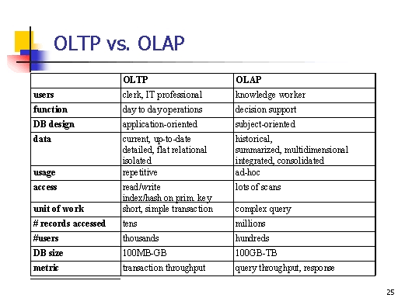

Slide 16
Actors on the Scene

Slide 17
Small personal database
list of addresses
one person typically
defines, constructs, and
manipulates the database, and there is no sharing.
Large organizations
Many people are involved in the
design,
Use, and maintenance
of a large database with hundreds or thousands of users.

Slide 18
Persons
Actors on the Scene
Database Administrators
Database Designers
End Users
System Analysts and Application Programmers
Workers behind the scene
DBMS system designers and implementers
Tool developers
Operators and maintenance personnel

Slide 19
1.Database Administrators
In any organization
Where many people use the same resources
Need an administrator to manage these resources.
In a database environment
the primary resource is the database itself,
secondary resource is the DBMS and related software.

Slide 20
1.Database Administrators
Administering these resources is the responsibility of the database administrator (DBA).
The DBA is responsible for
authorizing access to the database,
coordinating and monitoring its use, and
acquiring software and hardware resources as needed.
The DBA is accountable for problems such as
security breaches and
poor system response time.
In large organizations,
the DBA is assisted by a staff that carries out these functions.

Slide 21
2. Database Designers
Database designers are responsible for
identifying the data to be stored in the database and
choosing appropriate structures to represent and store this data.
These tasks are mostly undertaken before the database is actually implemented and populated with data.
It is the responsibility of database designers to communicate with all prospective database users in order to understand their requirements and to create a design that meets these requirements.

Slide 22
2. Database Designers
In many cases, the designers are one of the DBA and may be assigned other staff responsibilities after the database design is completed.
Database designers typically interact with each potential group of users and develop views of the database that meet the data and processing requirements of these groups.
Each view is then analyzed and integrated with the views of other user groups.
The final database design must be capable of supporting the requirements of all user groups.

Slide 23
3.End Users
End users are the people whose jobs require access to the database for querying, updating, and generating reports
Casual end users
occasionally access the database, different information each time.
but they may need
They use a sophisticated database query interface to specify their requests and are typically middle- or high-level managers.

Slide 24
3.End Users
Naive or parametric end users
make up a sizable portion of database end users.
Their main job function revolves around constantly querying and updating the database,
using standard types of queries and updates—called canned transactions—that have been carefully programmed and tested.

Slide 25
3.End Users
Sophisticated end users
Include engineers, scientists, business analysts, and others who thoroughly familiarize themselves with the facilities of the DBMS in order to implement their own applications to meet their complex requirements.
Standalone users
Maintain personal databases by using ready-made program packages that provide easy-to-use menu-based or graphics- based interfaces.
An example is the user of a financial software package that stores a variety of personal financial data.

Slide 26
4.System Analysts and Application
Programmers
System analysts
Determine the requirements of end users, especially naive and parametric end users
Develop specifications for standard canned transactions that meet these requirements.
Application programmers implement these specifications as programs; then they test, debug, document, and maintain these canned transactions.
Such analysts and programmers—commonly referred to as software developers or software engineers—should be familiar with the full range of capabilities provided by the DBMS to accomplish their tasks.

Slide 27


